Slide 1
Senior Cafe
Done By:
Bhavya Chandrappa Sogra Bilal Memon
Data Scientist Data Engineer

Slide 2
Data Source
Census Canada
Contains: Population , Income , Language, Family size Distribution per town

Slide 3
Problem Statement
Census data has potential but unstructured
New Business need validation

Slide 4
Business Idea and Value Proposition
Small businesses
Investors
Market Research

Slide 5
Sprints
Sprint No | Task
Sprint 1 | Data Collection
Sprint 2 | Extract, Transform and Loading Process
Sprint 3 | Querying the data
Sprint 4 | Visualization

Slide 6
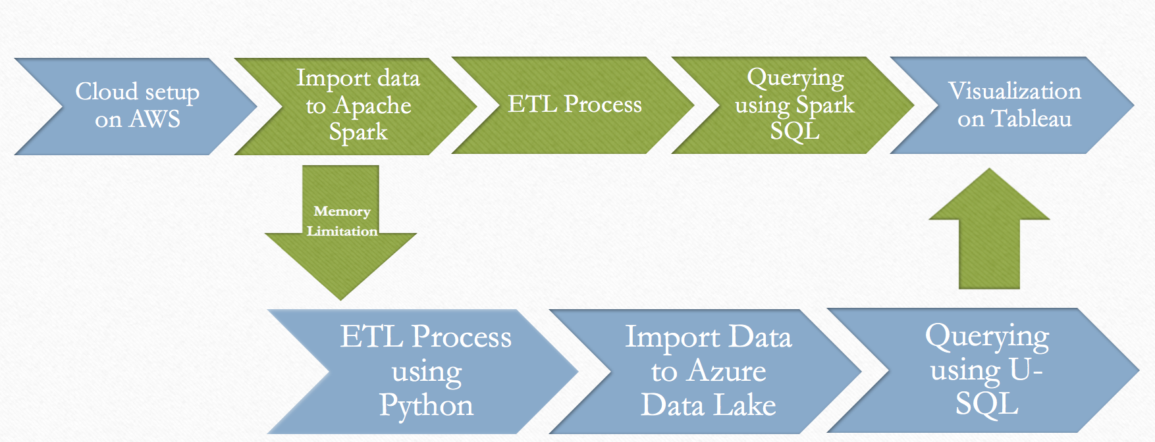
Tools and Implementation

Slide 7
Limitations And Future Work
Limitations
Unstructured Data
Static Data
Future work:
Build a front end
Perform predictions

Slide 8
Thank you
Any Questions ?

